Slide 1
EPA143A: Macroeconomics for Policy Analysis Week 5: The IS-LM model
The IS-LM model is a macroeconomic model which consists of two parts:
the IS part, which describes the ‘goods market’ based on the (ex-post) equilibrium condition that investment (I) is equal to savings (S); and
the LM part, which describes the ‘money market’ based on the (ex-post) equilibrium condition that the demand for money (or liquidity L) must equal the exogenous supply of money (M).

Slide 2
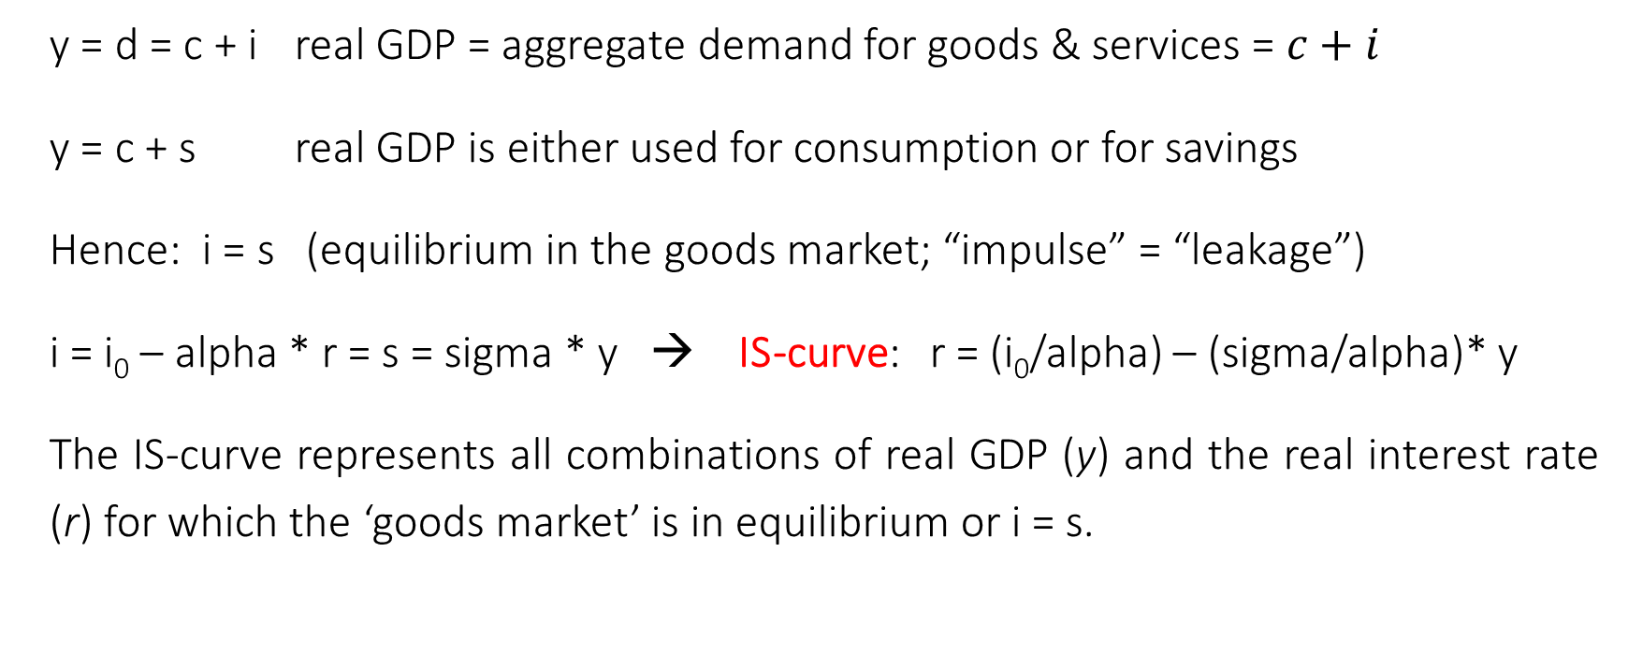
EPA143A: Macroeconomics for Policy Analysis Week 5: The IS-equation
y = d = c + i real GDP = aggregate demand for goods & services = $c+i$
y = c + s real GDP is either used for consumption or for savings
Hence: i = s (equilibrium in the goods market; “impulse” = “leakage”)
i = i₀ – alpha * r = s = sigma * y → IS-curve: r = (i₀/alpha) – (sigma/alpha)* y
The IS-curve represents all combinations of real GDP (y) and the real interest rate (r) for which the ‘goods market’ is in equilibrium or i = s.

Slide 3
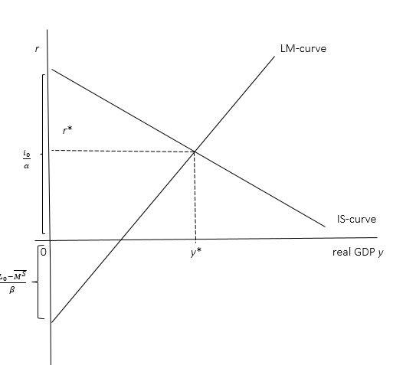
EPA143A: Macroeconomics for Policy Analysis Week 5: The IS-LM model
The standard
IS-LM model:
Macro-economic
equilibrium
(y*, r*)

Slide 4
EPA143A: Macroeconomics for Policy Analysis Week 5: The IS-LM model
The Money Market:
Money supply Ms = Md money demand
Ms = exogenous (under the control of the central bank)
Md = L₁ + L₂
L₁ = transactions demand for money = v*p*y
L₂ = speculative demand for money = L₀ – beta*r (liquidity preference)

Slide 5
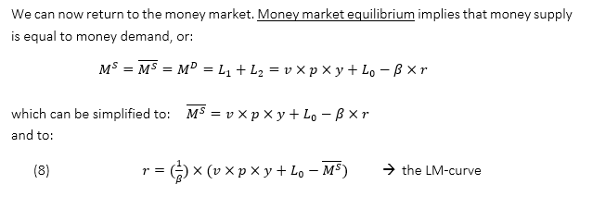
EPA143A: Macroeconomics for Policy Analysis Week 5: The IS-LM model
The LM-curve:

Slide 6
EPA143A: Macroeconomics for Policy Analysis Week 5: The IS-LM model
The standard
IS-LM model:
Macro-economic
equilibrium
(y*, r*)

Slide 7
EPA143A: Macroeconomics for Policy Analysis Week 5: The IS-LM model
Money demand L₂ and the bond market: L₂ = L₀ – beta*r
A government is issuing a new bond of (say) euro 10000, for 5 years, paying 3% in interest per year in the primary bond market.
You can “buy” that newly issued bond by lending euro 10000 to the government. The government borrows euro 10000 from you, for 5 years, and promises to pay 3% in interest per year. After 5 years, the government will pay back the loan (euro 10000) to you.
The bond is not written in your name. If you need cash, you can sell your bond in the secondary bond market.
Suppose you decide to sell your bond in year 2; the interest rate in year 2 is 1%. This means that your bond is an attractive financial investment; buyers will be willing to pay more than euro 10000 for your bond.
Hence, if the current interest rate is lower than earlier, bond prices in the secondary market will be relatively high. Speculators may be unwilling to buy these expensive bonds, if they expect that the interest rate will rise in the future.

Slide 8
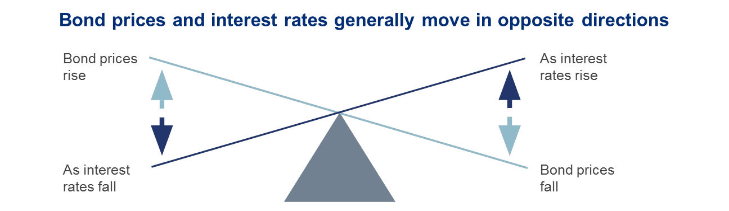
EPA143A: Macroeconomics for Policy Analysis Week 5: The IS-LM model
Bond prices (in the secondary market) and the interest rate

Slide 9
EPA143A: Macroeconomics for Policy Analysis Week 5: The IS-LM model
Money demand L₂ and the bond market: L₂ = L₀ – beta*r
if r is high (now), the prices of (older) bonds in the secondary market (paying lower interest rates) will be low; speculators will buy bonds in the primary and secondary market and reduce their cash holdings.
if r is low (now), the prices of (older) bonds in the secondary market (paying higher interest rates) will be high; bonds are “expensive” and speculators will not buy bonds (but keep their cash holdings, to wait for “better times”).

Slide 10
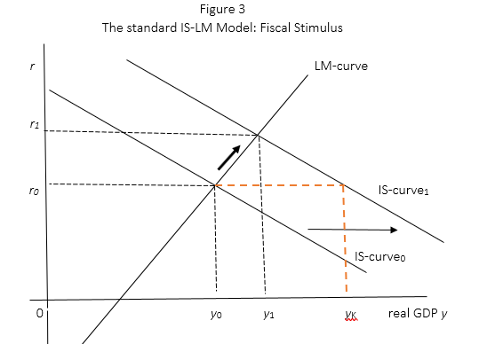
EPA143A: Macroeconomics for Policy Analysis Week 5: The IS-LM model
The effects
of fiscal policy:
partial
crowding out

Slide 11
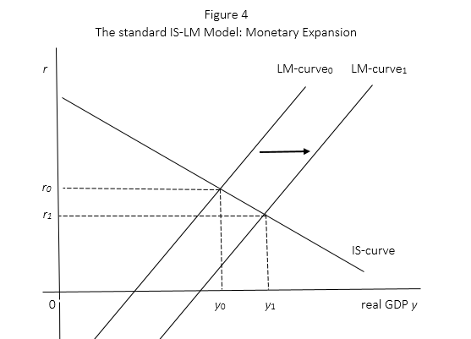
EPA143A: Macroeconomics for Policy Analysis Week 5: The IS-LM model
The effects
of monetary policy:
crowding in

Slide 12
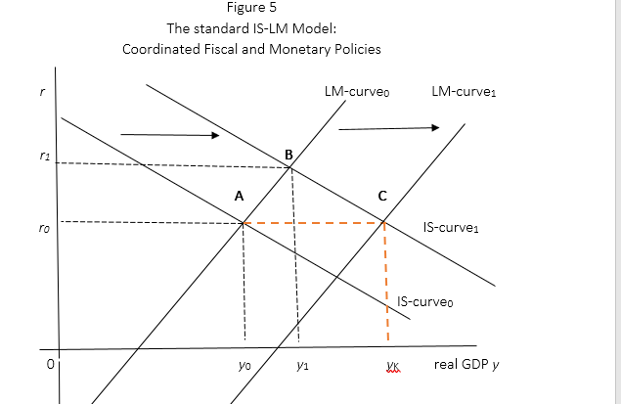
EPA143A: Macroeconomics for Policy Analysis Week 5: The IS-LM model
Coordination of
Fiscal and
monetary policy

Slide 13
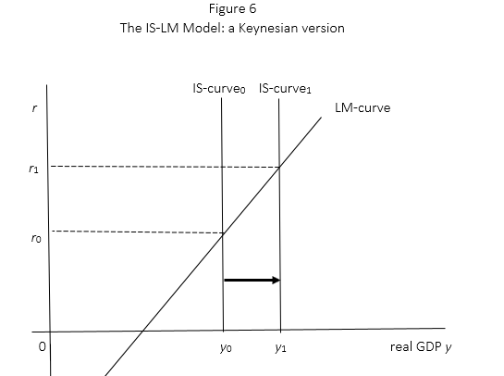
EPA143A: Macroeconomics for Policy Analysis Week 5: The IS-LM model
A first special case:
alpha = 0;
investment is
autonomous;
a Keynesian case

Slide 14
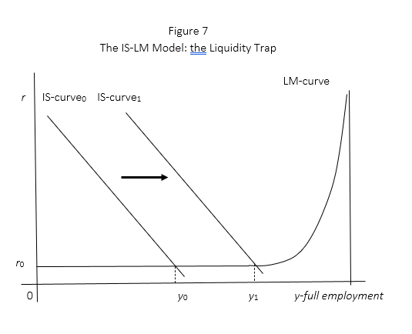
EPA143A: Macroeconomics for Policy Analysis Week 5: The IS-LM model
A 2nd special case:
The liquidity trap

Slide 15
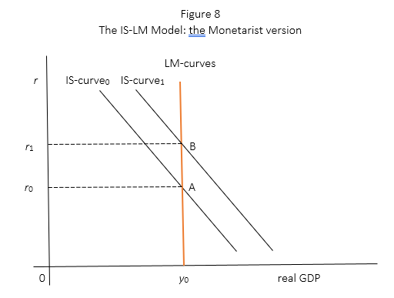
EPA143A: Macroeconomics for Policy Analysis Week 5: The IS-LM model
A 3rd special case:
Monetarism
L₂ = 0;
complete crowding
out of fiscal
stimulus

